Slide 1


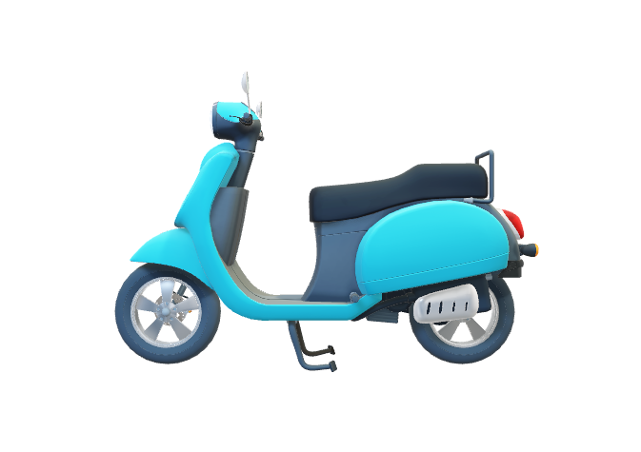
MBA BAI SEM - 2
MBA BAI SEM - 2
Presented By –
KHUSHI. P 012300400013002015
NILA
012300400013002018
YASHVI MISTRY 012300400013002030
PARTH CHELANI 012300400013002019
INTRODUCTION TO PYTHON AND R
MBABI-SII-05
Presented To –
Dr. Hetal Thaker
Asst. Professor
NFSU

Slide 2
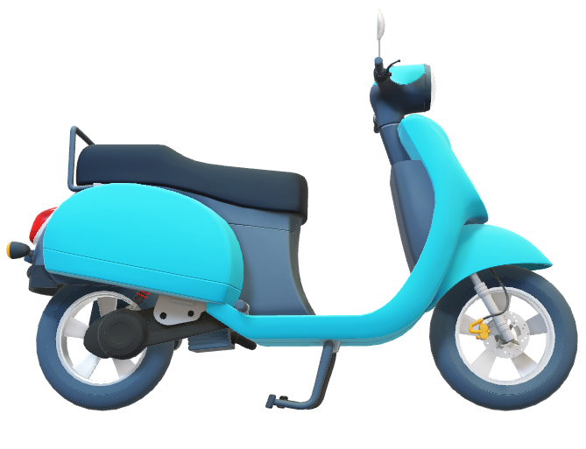
FOOD DELIVERY
FOOD DELIVERY
How BI is Helping the Food Delivery Industry to grow.

Slide 3

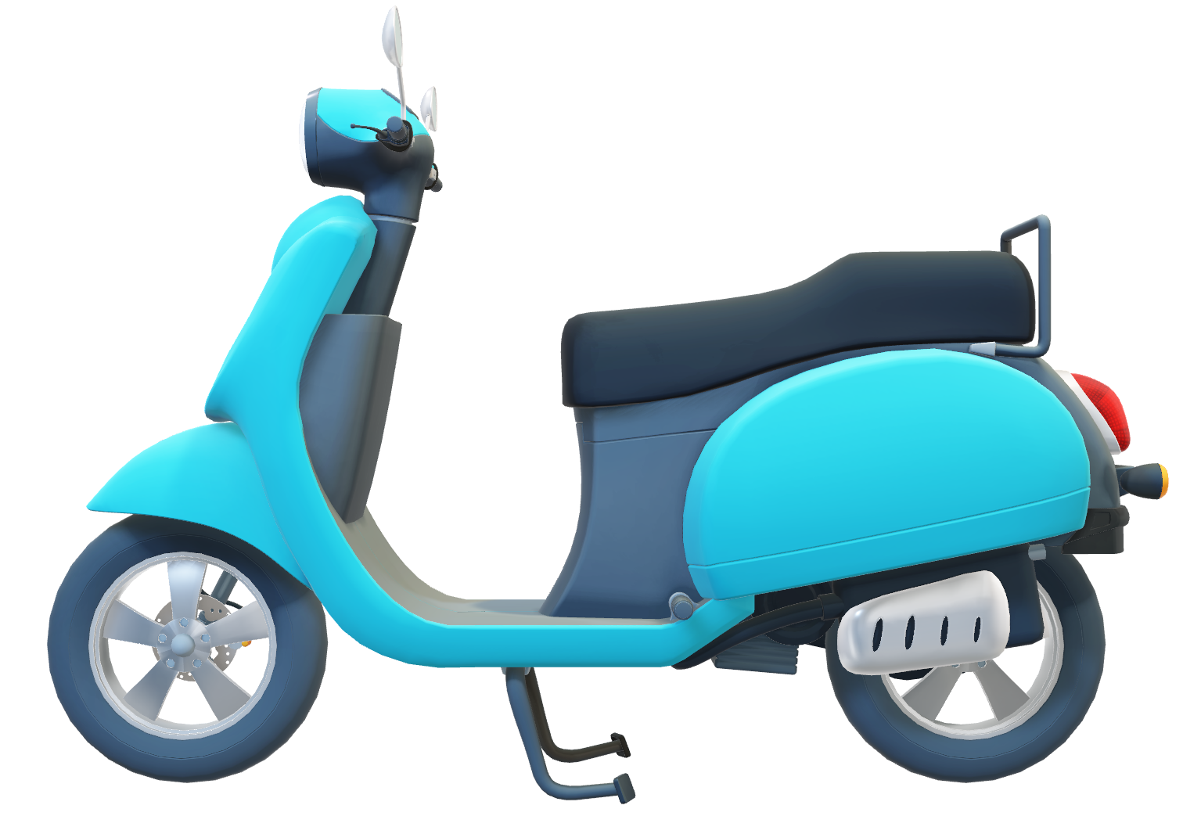
About dataset
01

Slide 4

About dataset
This dataset contains information is of Zomato.ltd and the information is related to food and the restaurants in India. Attributes lwhich includes name, establishment, url, address, city, city_id, locality, latitude, longitude, country_id, locality_verbose, cuisines, timings, average_cost_for_two, price_range, currency, highlights, aggregate_rating, rating_text, votes, photo_count, delivery, takeaway.

Slide 5

02
DATA PRE-PROCESSING

Slide 6
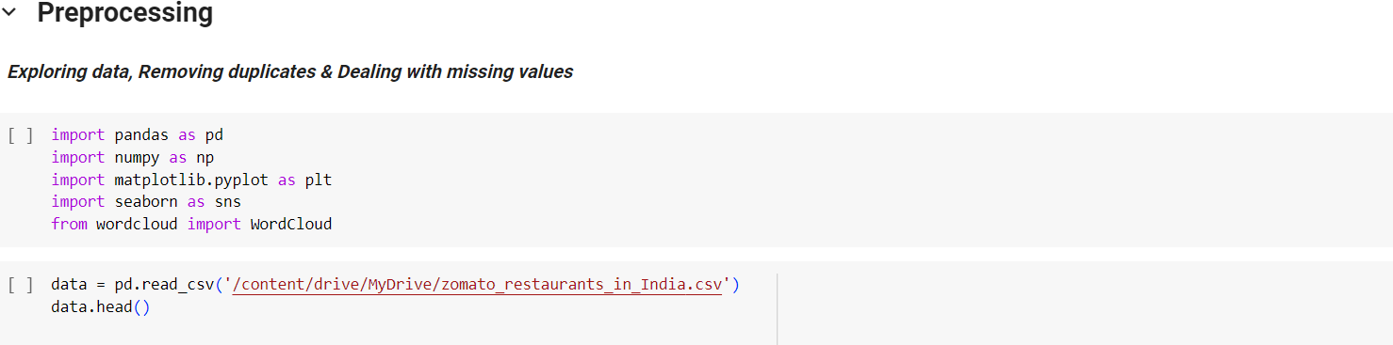
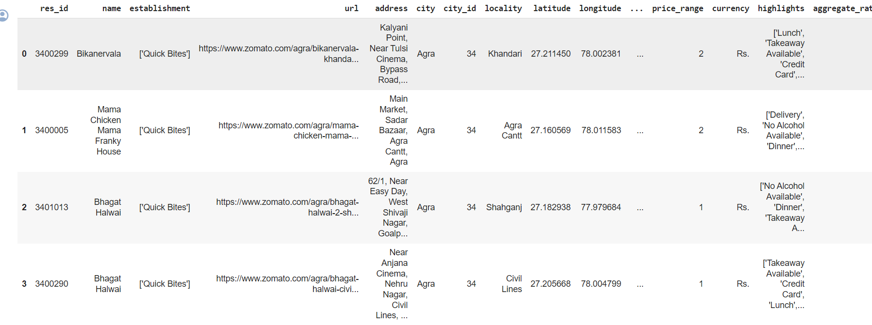

Slide 7
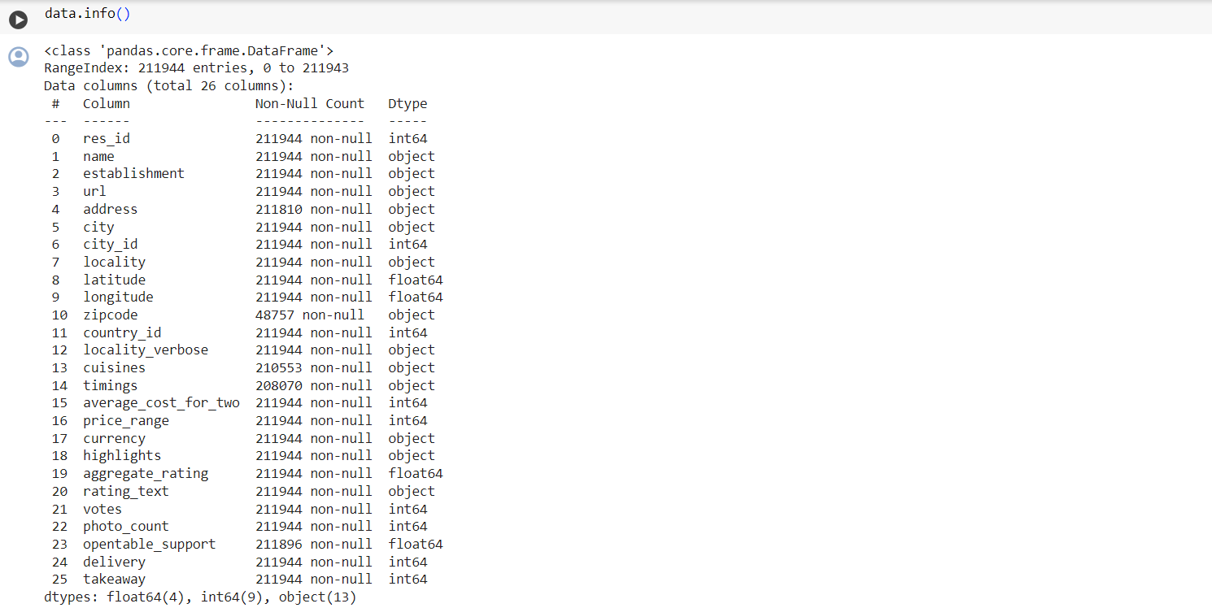


Slide 8

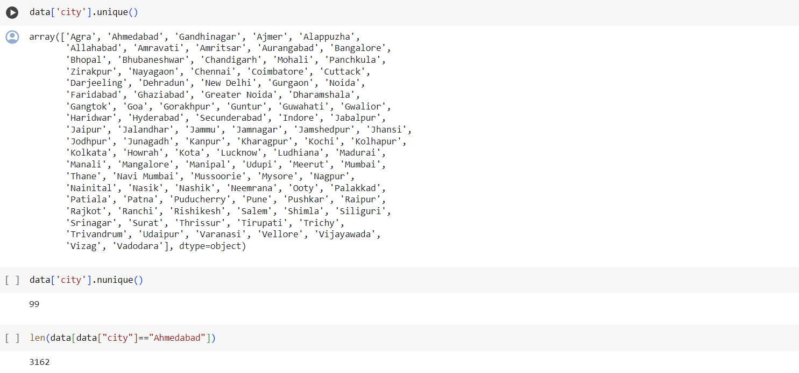


Slide 9
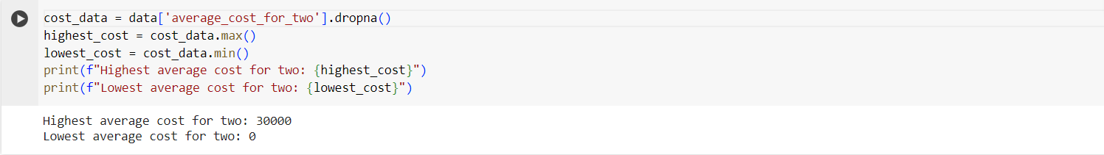
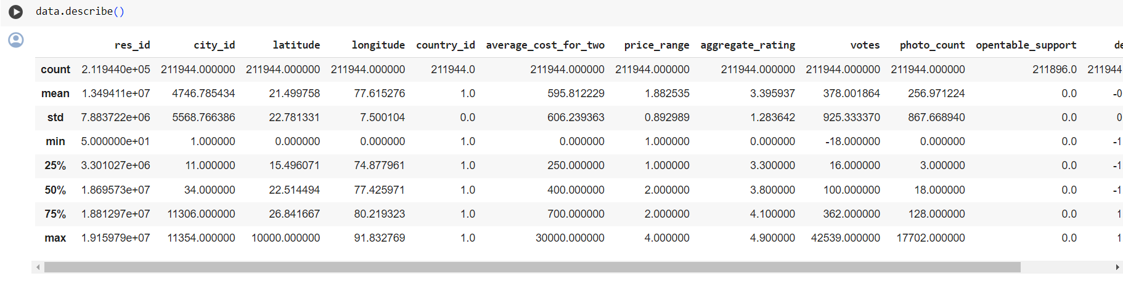


Slide 11
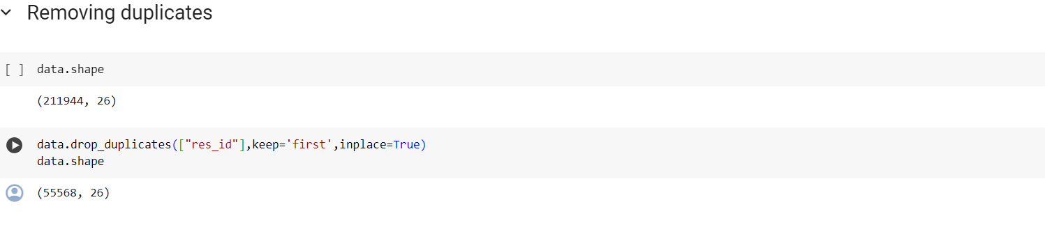
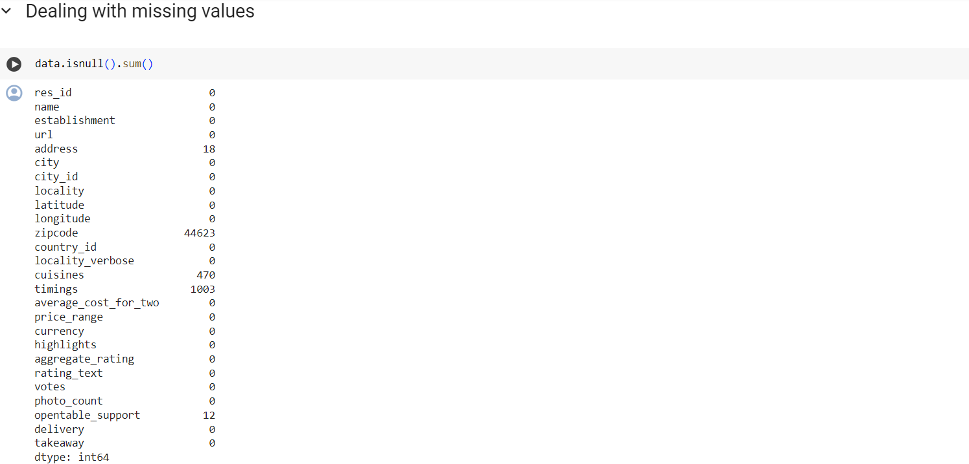

Slide 12

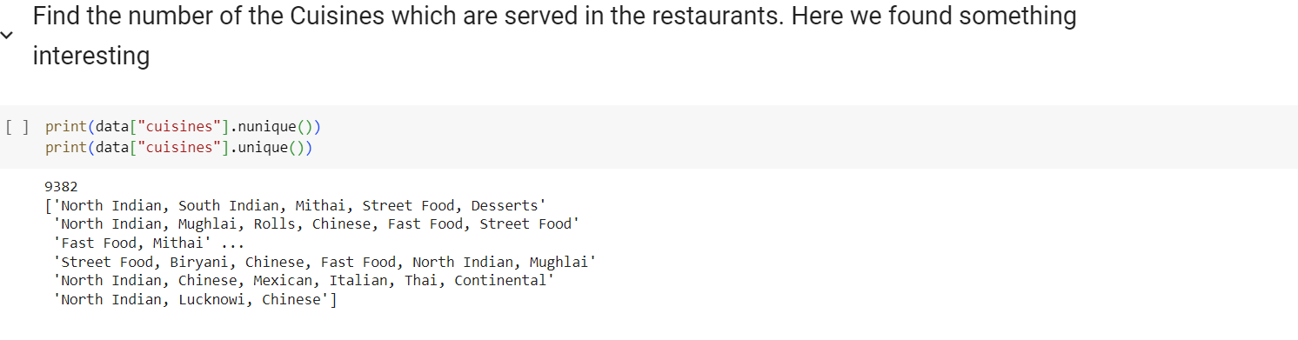
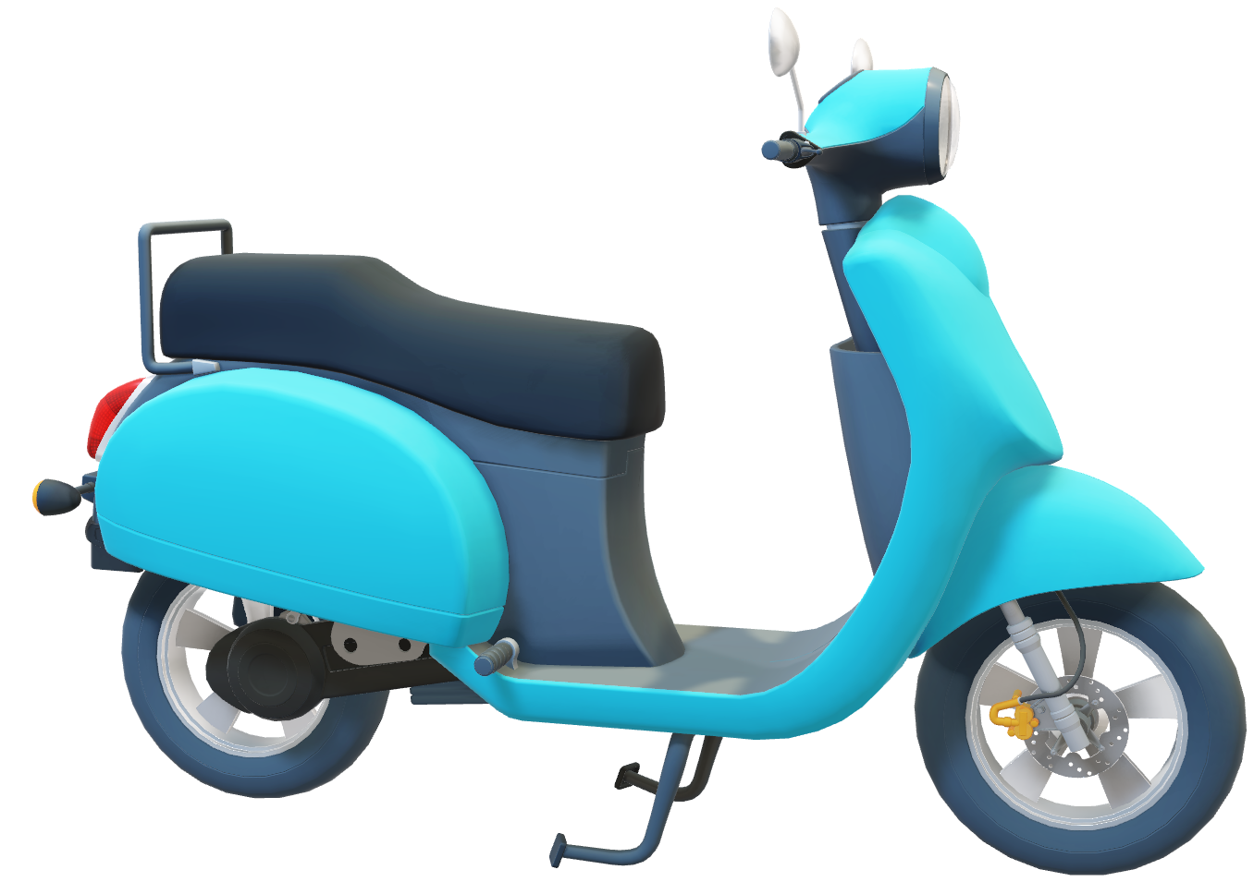
F
O
O
D
C
O
O
K

Slide 13
EDA
03

Slide 14
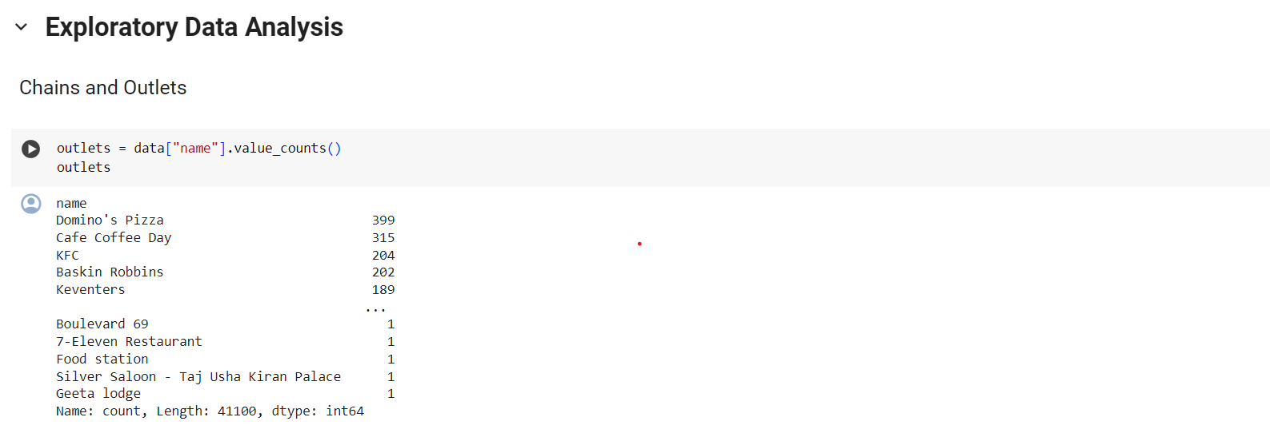
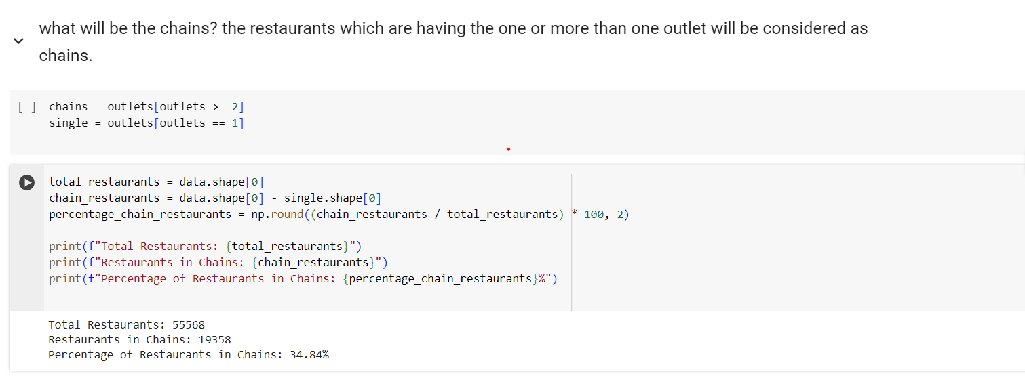

Slide 15
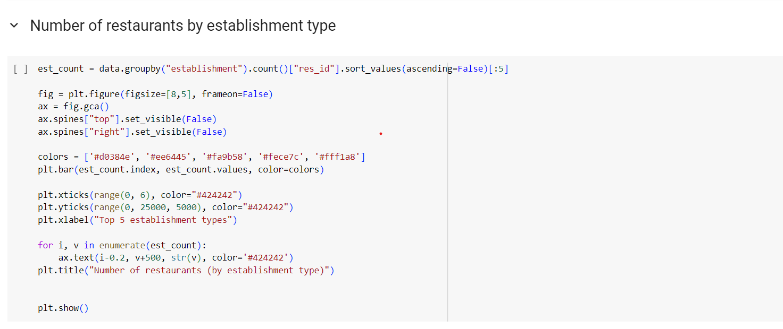
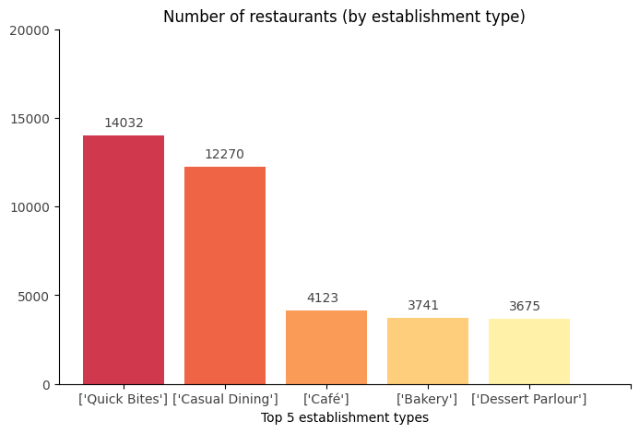


Slide 16
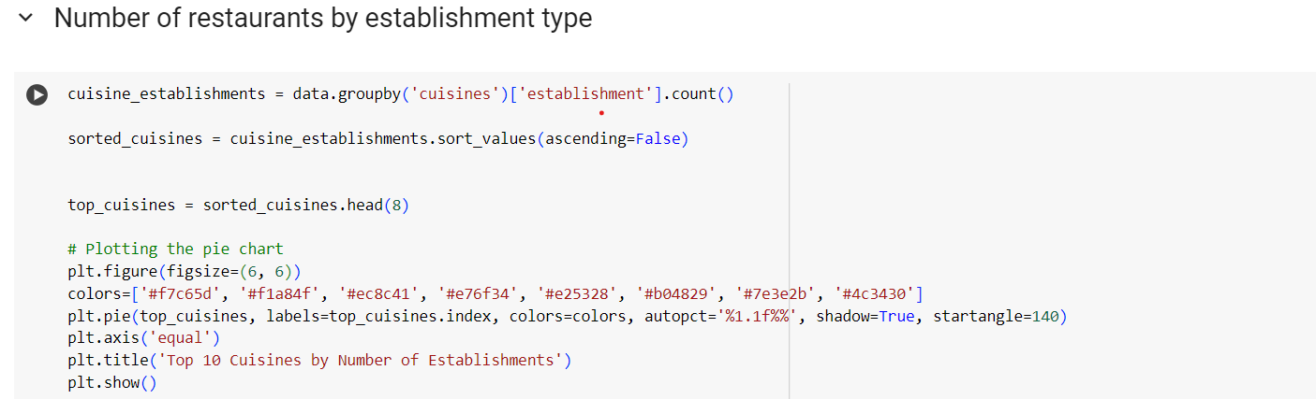
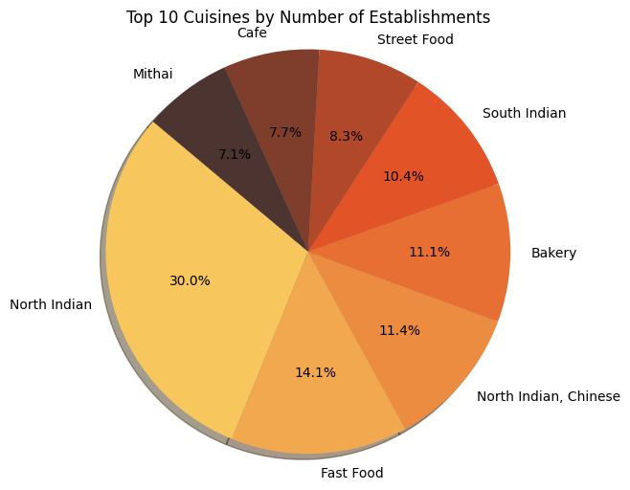

Slide 17



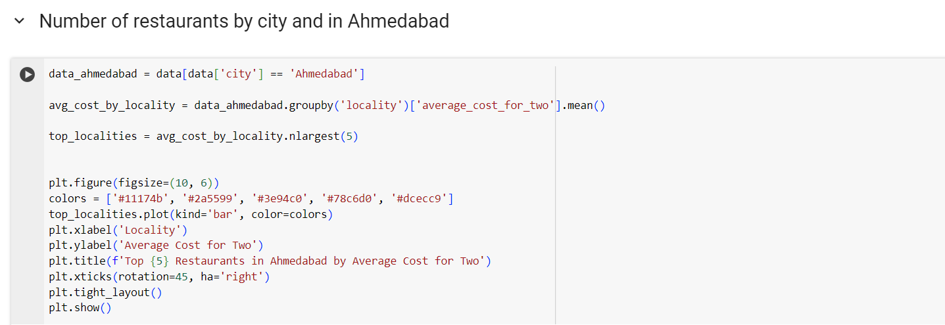
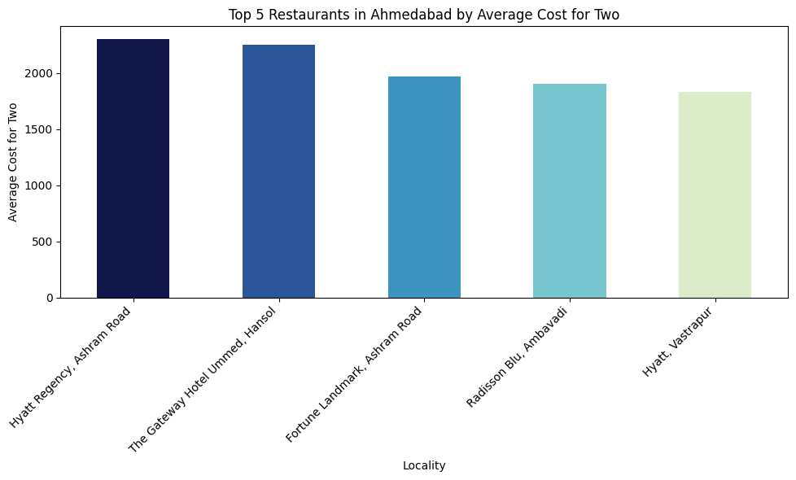

Slide 18
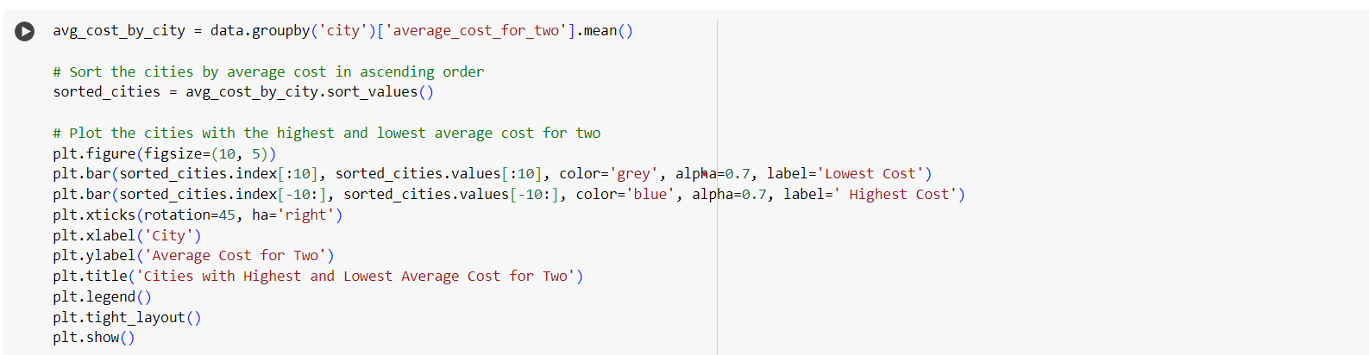
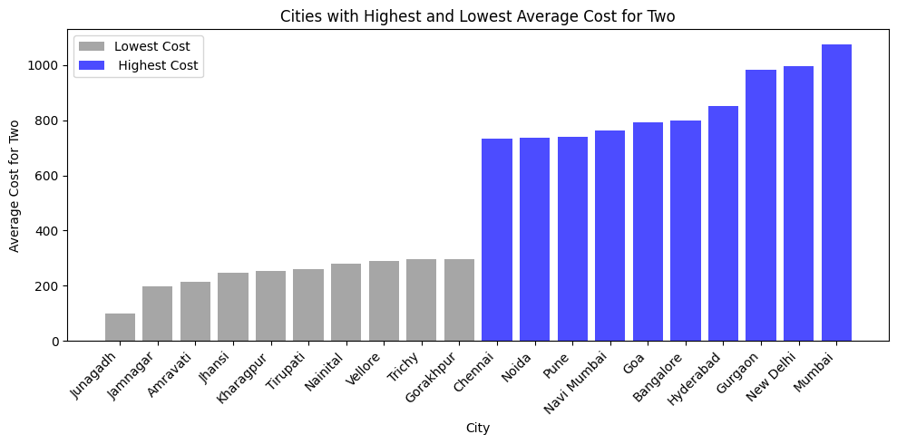

Slide 19
04
RELATIONSHIP BETWEEN TWO VARIABLES

Slide 20
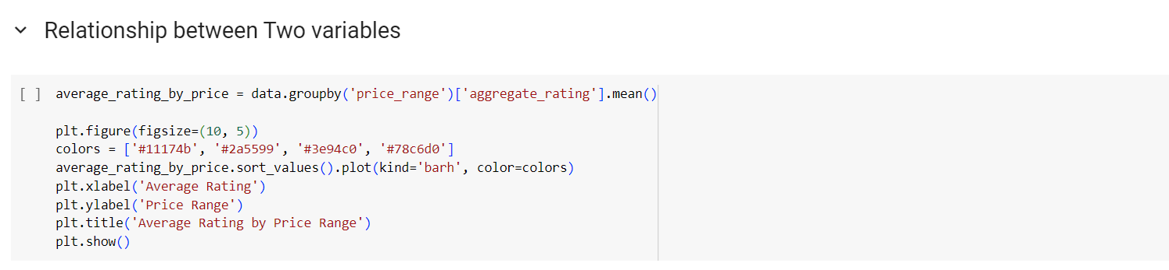
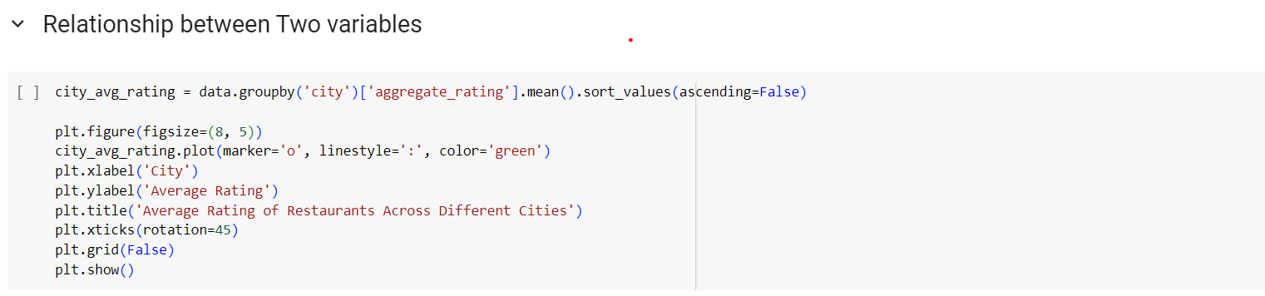
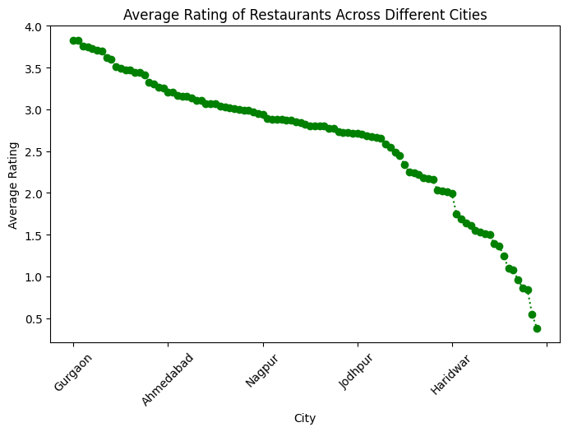
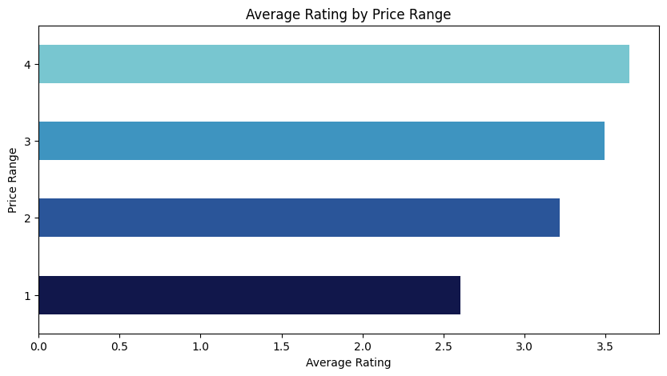

Slide 22
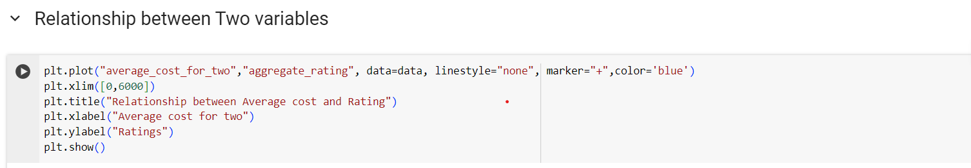
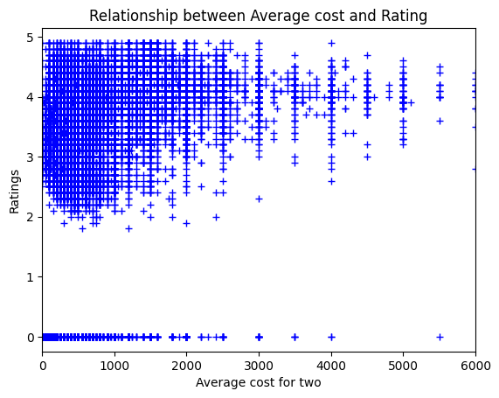
F
O
O
D
C
O
O
K

Slide 23
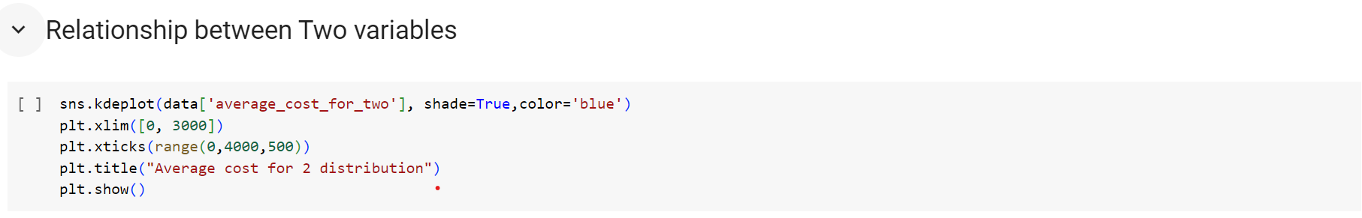
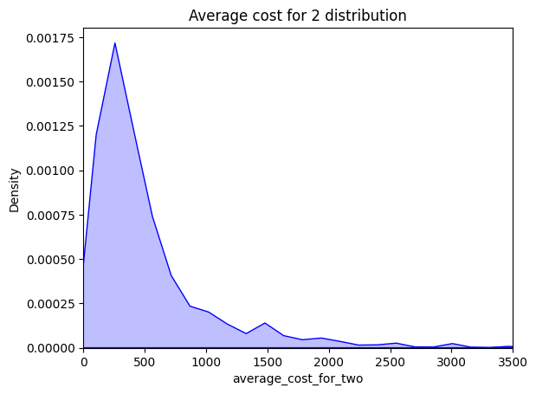

Slide 24
Guidance to Crack the Interview at First Go
PHONE
PERSONALITY
REFERENCES
PERMANENT
WORK
QUALIFICATIONS
FORMS
COMPENSATION
TIE
CAREER
SUCCESS
EDUCATION
TIPS
PORTFOLIO
JOB
SKILS
DEGREE
TEMPORARY
INSURANCE
INTERVIEW
SALARY
TEST
BENEFITS
IMPRESS
PROGRAMS
POLITE
RESUME
KEYWORDS
EMPLOYMENT
EXPERIENCE
CANDIDATES
BUSINESS
APPLICATION
Learn to tackle the tricky questions
Present yourself well
Be observant\
Observe your nonverbal communication
Know your Company
QUESTIONS
TEAM
SCREENING
VIIRTUAL
TRAINING
SKILLS
AGENCY
OBJECTIVE

Slide 25
FORMS
PERMANENT
PHONE
PERSONALITY
IMPRESS
INSURANCE
PROGRAMS
REFERENCES
QUALIFICATIONS
POLITE
TEMPORARY
JOB
EDUCATION
SUCCESS
TIPS
SALARY
SKILS
TIE
WORK
PORTFOLIO
CAREER
COMPENSATION
RESUME
QUESTIONS
BENEFITS
TEST
EXPERIENCE
INTERVIEW
DEGREE
CANDIDATES
EMPLOYMENT
TEAM
BUSINESS
SCREENING
SKILLS
APPLICATION
TRAINING
VIIRTUAL
AGENCY
OBJECTIVE
Thank You

Slide 26

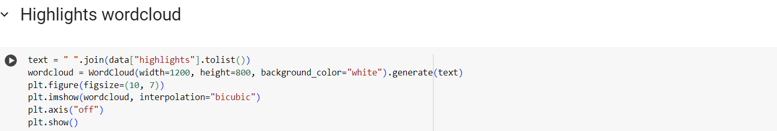
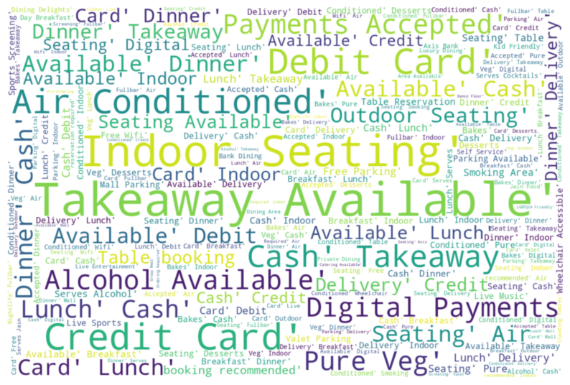


Slide 27
TOMATO
HANK
YOU

